Slide 1
Using Artificial Intelligence in the field of Diagnostics
Neeyanth Kopparapu
Cofounder, GirlsComputingLeague
Sophomore, Thomas Jefferson High School
@neeyanth @GirlsComputingLeague

Slide 2
2,500,000,000
Gigabytes of data produced daily
Notes:
Say the Statistic, then say “5 years ago our current state of technology could not keep up… this is really where artificial intelligence began to rise”

Slide 3
80%
Percent of World’s Population in low-income communities.
Notes:
Stay statistic… “More specifically, AI has started to rise in the field of medicine and healthcare because there are many people that can’t access the expensive healthcare systems in many countries today”

Slide 4
AI IN DIAGNOSTICS
Large amount of data perfect for AI
Room for improvement
Millions of lives affected by improvements in this field
Notes:
“AI has a lot of potential in diagnostics since the modern data revolution… each medical device from MRI scanners to Glucose Meters record data to send to a doctor or to store for a patient. AI can capitalize on this information to form predictions.

Slide 5
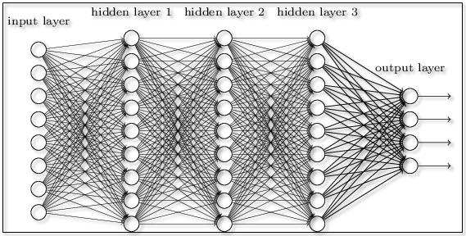
What is a Neural Network?
Notes:
“In general, NN’s in the most basic sense are just layers of neurons that are connected with neurons in other layers. To send information through the neuron, the signal is passed through a neuron, send through a nonlinear function, and if the final number exceeds a threshold, it fires to all of its connections, until it reaches the output layer, whose information is passed to the user… Backpropogation involves adjusting weights to fit information that was passed better.
Talk about what happens for the rest of the presentation.

Slide 6
AI for Diabetic Retinopathy
Eyeagnosis Teammates:
Neeyanth Kopparapu
Kavya Kopparapu
Justin Zhang
1
Notes:
First application I worked on was using AI for Diabetic Retinopathy

Slide 7
332,000,000
Diabetic patients in middle-low income communities

Slide 8
> 50%
Estimated cases of diabetes still undiagnosed

Slide 9
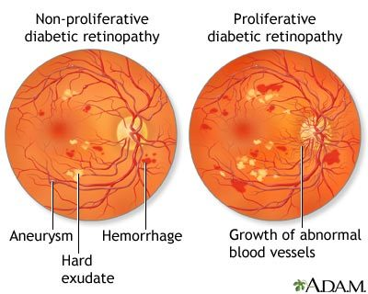
Notes:
Explain what Diabetic Retinopathy is a complication of diabetes that affects the eye, caused by damage to blood vessels, and poorly controlled blood sugar.

Slide 10
PROBLEM
Diagnosis for Diabetic Retinopathy needs to be:
Inexpensive
Quick
Accessible
(finally) Accurate

Slide 11
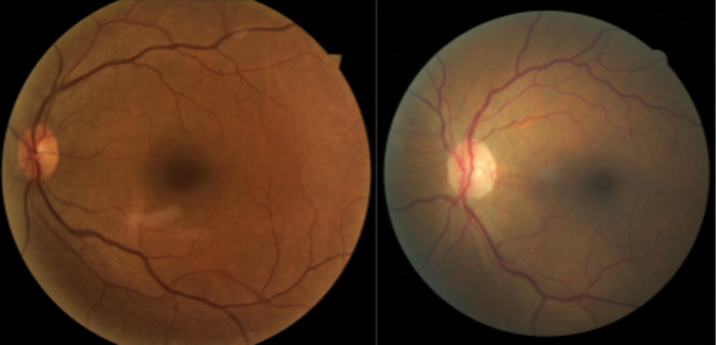
Notes:
DR Is RIGHT?? LOOKS IDENTICAL!

Slide 12
USING ARTIFICIAL INTELLIGENCE
Efficient
Subjectivity
Requires >2 hours/patient
Ophthalmologist : Patient > 1:1000
Inexpensive
Current diagnostic tools are expensive
Pathologist required to diagnose

Slide 13
DRAFTING A SOLUTION
Accessibility → use a common devices
Inexpensive → don’t use expensive equipment
Quick → AI models are very quick
Diabetic Retinopathy → common procedures include dilated eye exam, fluorescein angiography, optical tomography
Notes:
Dialiated Eye Exam → Eyedrops and then Retinal Image
Fluorescein Angiography → Using injected dye to pinpoint broken & closed blood vessels.
Optical tomography → shows thickness of retina.

Slide 14
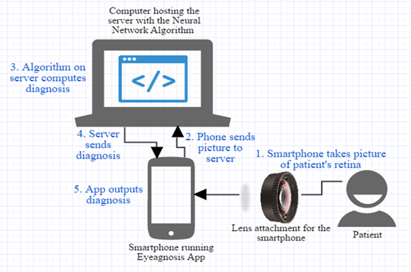
SOLUTION

Slide 15
NEXT STEPS
Assemble Dataset
NIH eyeGENE Dataset of retinal images
Train Model
ResNet-50 Convolutional Neural Network
Create Supporting Technology
Mobile Application
Lens Holder

Slide 16
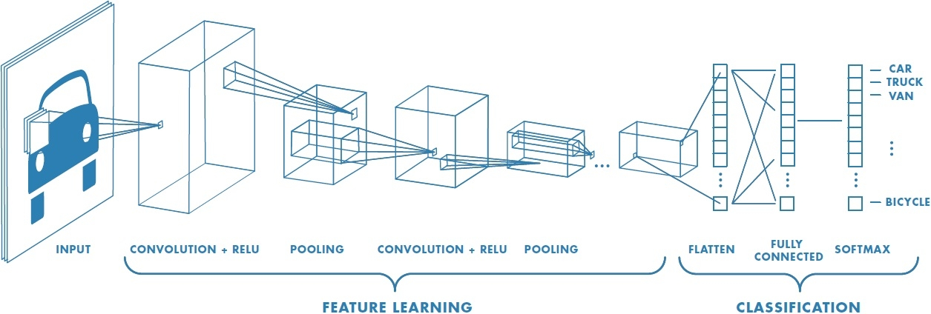
What is a Convolutional Neural Network?

Slide 17
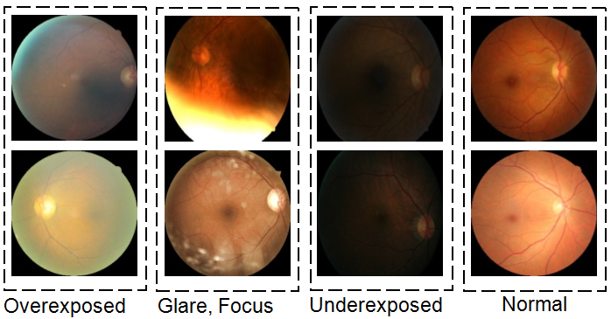
DATASET

Slide 18
MODEL ARCHITECTURE

Slide 19
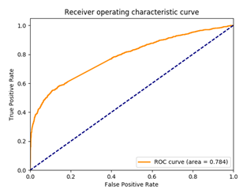
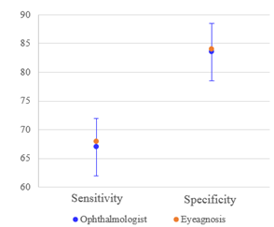
MODEL RESULTS

Slide 20
SUPPORTING TECHNOLOGY
Mobile Application
Facilitate Transfer of Image
Preprocess Image
Lens System
Holds multiple lenses
Better picture of the Retina

Slide 21
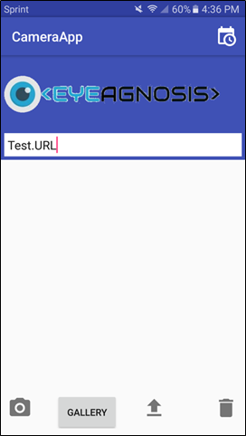
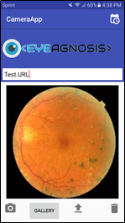
MOBILE APPLICATION

Slide 22
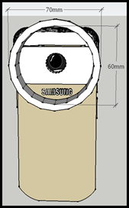
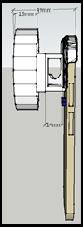
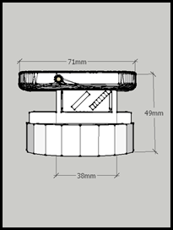
LENS SYSTEM

Slide 23
Can We Do Better?
2

Slide 24
HOW CAN WE IMPROVE?
Accessibility
Accuracy
Trust

Slide 25
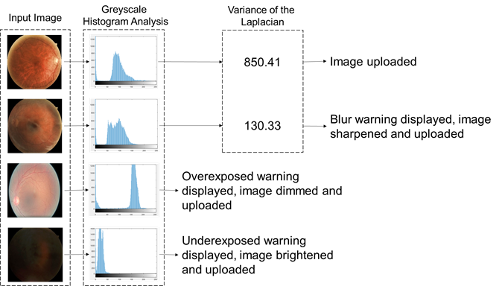
MOBILE APPLICATION

Slide 26
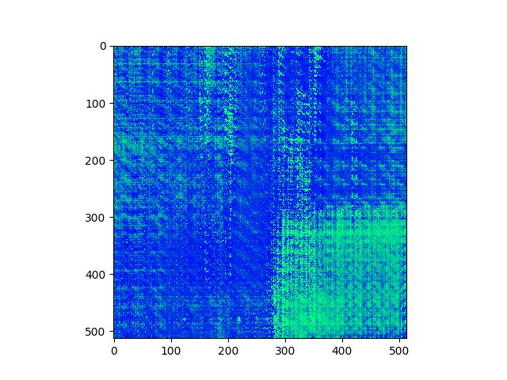
IMPROVING TRUST

Slide 27
AI for Major Depressive Disorder
TweePression teammates:
Neeyanth Kopparapu
Kaien Yang
3

Slide 28
41.6%
Percent of Students with Depression

Slide 29
43%
Percent of Students with Depression that seek help

Slide 30
A DIFFERENT PROBLEM
Accurate
Current depression screening methods have accuracies under 75%
Non-Intrusive
Over 40% of adults keep depression symptoms to themselves
Opening up to doctors is harder than online (Social Media)

Slide 31
DRAFTING A SOLUTION
Accuracy → Bigger collection of data, more viewpoints
Non-Intrusive → Social Media?

Slide 32
USING ARTIFICIAL INTELLIGENCE
Sentiment Analysis
From individual social media posts, calculate sentiment of user
Depression Prognosis
From Sentiment Analysis, give final prediction about user.

Slide 33
INITIAL APPROACH
Classify each word individually
Combine classifications for final output

Slide 34
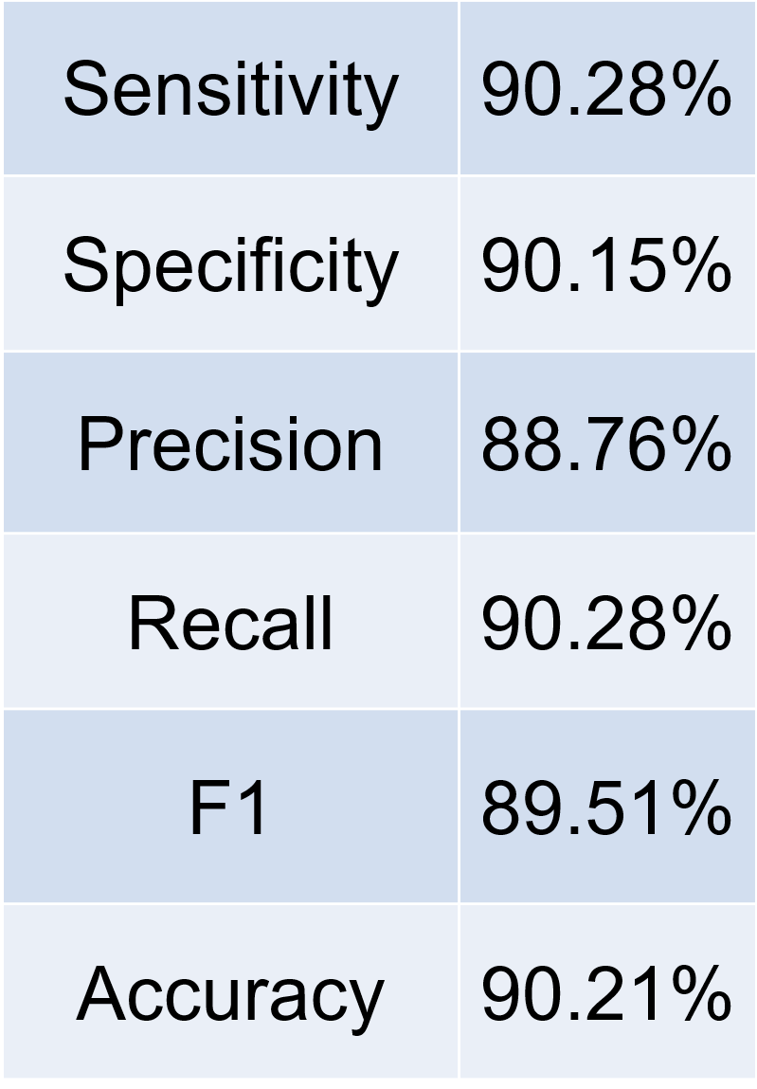
RESULTS
Condition Positive | Condition Negative
 | Test Positive
 | Test Negative
False Positive 13,233 (Type I Error)
True Positive 104,460
False Negative 11,242 (Type II Error)
True Negative 121,065

Slide 35
Can We Do Better?
4

Slide 36
REANALYZING THE PROBLEM
The main goal of using AI is to increase accuracy
Using as much data as possible is beneficial
Accessibility isn’t the immediate problem
Using medical machines to increase data output

Slide 37
BAG OF WORDS
“How could I hate you?”
“He said he loved ONLY me” vs “He said ONLY he loved me”
How
You?
Could
Hate
I

Slide 38
NEW MODEL
DENSE NEURAL NETWORK
Sentiment Analysis Dataset
Kaggle Movie Reviews Dataset
OUTPUT:
SOFTMAX ACTIVATION
2: CONVOLUTIONAL LAYER
5: DENSE LAYER
4: DENSE LAYER
1: EMBEDDING LAYER
3: MAX POOLING 2D LAYER
Google Word2Vec

Slide 39
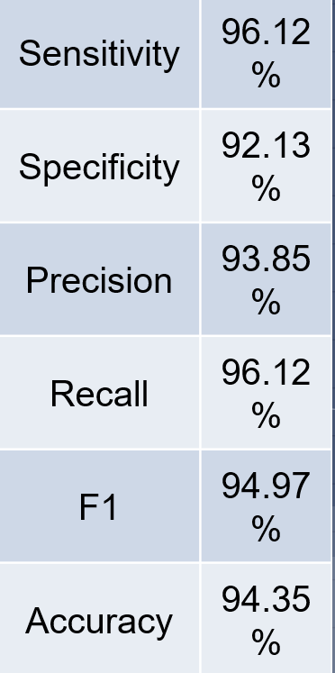
RESULTS
Condition Positive | Condition Negative
 | Test Positive
 | Test Negative
False Positive 15,738 (Type I Error)
True Positive 240,303
False Negative 9,702 (Type II Error)
True Negative 184,257

Slide 40
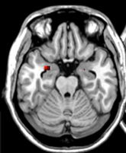
FMRI ANALYSIS MODEL
Classification Output:
MDD Prediction
Image Input:
fMRI Scans
Convolution + ReLU
Max pooling
Fully Connected + ReLU
Softmax

Slide 41
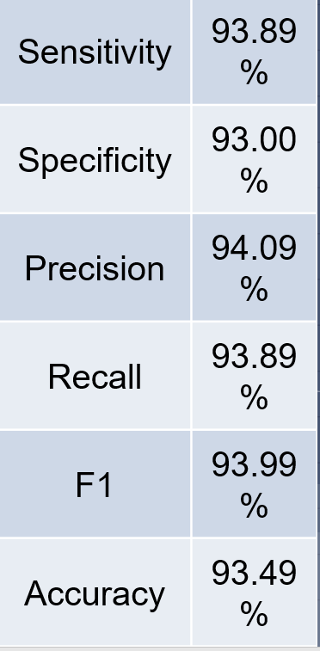
FMRI RESULTS
Condition Positive | Condition Negative
 | Test Positive
 | Test Negative
False Positive 28 (Type I Error)
True Positive 446
False Negative 29 (Type II Error)
True Negative 372

Slide 42
SUPPORTING TECHNOLOGY
Server to process queries
Validation of Social Media, Runs AI Model, Outputs Result
Website for user interface with access to social media pages

Slide 43
SERVER
no
MDD
yes
Depression
Free?
MDD
MRI Upload
Healthy
yes
> 100
Tweets?
yes
Healthy
Input
Twitter
Username
Valid
User
Name?
Insufficient Tweets
no
Invalid Username
no

Slide 44
Looking Forward
5

Slide 45
AI IN DIAGNOSTICS
Will it Replace Doctors?
Loss of Jobs?
How can we justify outputs?
Trust among patients?
How can we scale this?
What should be prioritized?
What happens if the AI is wrong?

Slide 46
CURRENT PROBLEMS IN AI
Biased datasets
Unethical training procedures
Inaccessibility to data

Slide 47
FINAL THOUGHTS
Diagnostics is the perfect field for AI
However, there is change that must come before
Explanations
Adaption toward specific communities

Slide 48
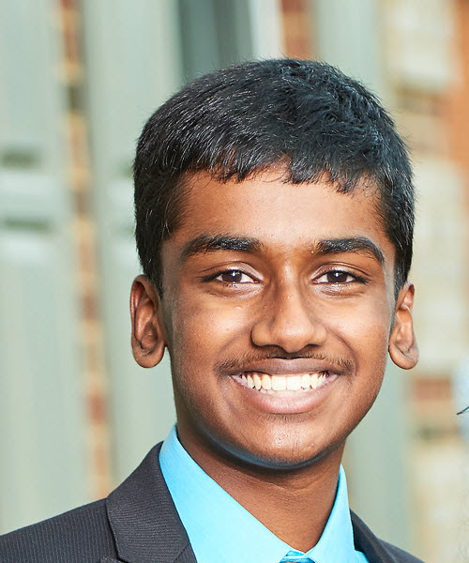
Thank You!
Neeyanth Kopparapu
GirlsComputingLeague
Sophomore, TJHSST
neeyanthkvk@gmail.com
@neeyanth

Slide 49
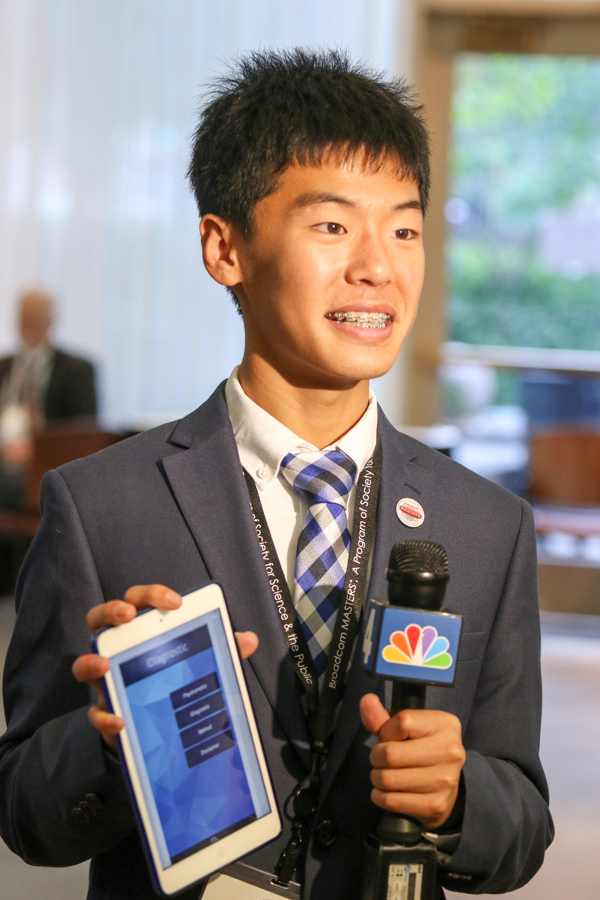
TweePression Researcher
Kaien Yang
Freshman, TJHSST
grandmasterkaien@gmail.com

Slide 50
Eyeagnosis Researcher
Justin Zhang
Senior, TJHSST
justinz2012work@gmail.com
Kavya Kopparapu
Senior, TJHSST
kavyakvk@gmail.com

